Slide 1
Uniform Circular Motion
Chapter 7.3

Slide 2
Uniform Circular Motion
Uniform circular motion is defined by any object that is moving at constant speed in a circular path.
Determining Speed:
The distance an object moving in a circular path is equal to the circumference (C = 2πr).
The time it takes an object to
complete one revolution is called
the period (T).
It then follows that the speed of
an object moving in a circular path
can be determined by:
v = d/t = C/T = 2πr/T

Slide 3
Example #1:
A 1500 kg racecar takes 1 minute to complete one lap of a circular racetrack with a radius of 400. meters.
Determine the speed of the racecar.
$$v=\frac{d}{t}=\frac{C}{T}=\frac{2πr}{t}$$
$$v=\frac{2π(400.m)}{60.s}=42m/s$$

Slide 4
Uniform Circular Motion
If an object is moving at constant speed in a circular path, can it be accelerating?
Yes
Although the speed may be constant,
the direction is changing.
If direction is changing over time,
then the velocity must be changing.
Acceleration is the change in
velocity over time (a = Δv/Δt).
And if the velocity is changing over time,
then the object must be accelerating.
v
v
v
v

Slide 5
Circular Motion – Instantaneous Velocity
The velocity vector is at right angles to the position vector
The velocity vector is tangent to the circle at any given point along the circle.
v₂
r₂
θ
r₁
-r₁
Δr
r₂
v₁
θ
$$v=\frac{Δr}{Δt}$$
r₁

Slide 6
Circular Motion – Centripetal Acceleration (a_{c})
The acceleration of an object moving in a circular path always points towards the center of the circle, and is perpendicular to the velocity vector.
v₂
-v₁
θ
v₂
Δ v
Δ v
Δr
v₁
$$a_{c}$$
$$a_{c} = \frac{Δv}{Δt}$$

Slide 7
Centripetal Acceleration
Note that while the direction of the position and velocity vectors change, their magnitudes do not.
The angle between r₁ and r₂ is the same as the angle between v₁ and v₂.
Therefore, the triangles these vectors make are similar such that:
If you divide both sides by Δt:
Where :
$r/t=v$and $v/t=a$
Hence:
and
$$\frac{Δr}{r}=\frac{Δv}{v}$$
r₂
θ
-r₁
Δr
$\frac{Δr}{Δt}∙\frac{1}{r}=\frac{Δv}{Δt}$ $∙\frac{1}{v}$
-v₁
θ
$$\frac{v}{r}=\frac{a}{v}$$
v₂
$$a_{c}=\frac{v^{2}}{r}$$
Δ v

Slide 8
Example #2:
In example #1, you determined the speed of a race car traveling around a circular racetrack to be 42 m/s.
Knowing that the radius of the racetrack is 400. meters, determine the centripetal acceleration of the racecar.
$$a_{c}=\frac{v^{2}}{r}$$
$$a_{c}=\frac{{(42 \frac{m}{s})}^{2}}{400m}$$
$$a_{c}=4.4 \frac{m}{s^{2}}$$

Slide 9
Centripetal Acceleration
An alternative representation for centripetal acceleration can be derived using the circumference and period of revolution.
$d=2πr$
$v=\frac{d}{T}=\frac{2πr}{T}$
Substituting into a_{c} = v²/r
$ac=\frac{{\left(\frac{2πr}{T}\right)}^{2}}{r}$
$ac=\frac{4π2r}{T2}$

Slide 10
Circular Motion – Centripetal Force
To make an object move in a circular path, an external force must act perpendicular or at right angles to its direction of motion.
This force is called centripetal force.
Instantaneous direction of velocity
Direction of force required to make object move in a circular path (towards the center)
$$F$$
$$a_{c}$$

Slide 11
Centripetal Force
Centripetal force is determined by:
The mass of the object (m).
The speed of the object around the circle (v).
The radius of the circle (r).
Using Newton’s 2nd Law of Motion (F_{c} = ma_{c}), centripetal force is mathematically represented as follows:
F_{c}
$$F_{c}=\frac{mv^{2}}{r}$$
Note: Centripetal force is an unbalanced “net” force

Slide 12
How the Factors Affect Centripetal Motion
$$F_{c}=\frac{mv^{2}}{r}$$
Which graph shows the proper relationship with respect to force:
Force vs. Mass.
Force vs. Speed.
Force vs. Radius.
Force
Speed
Force
Radius
Force
Mass

Slide 13
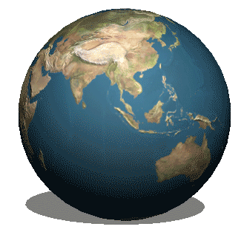
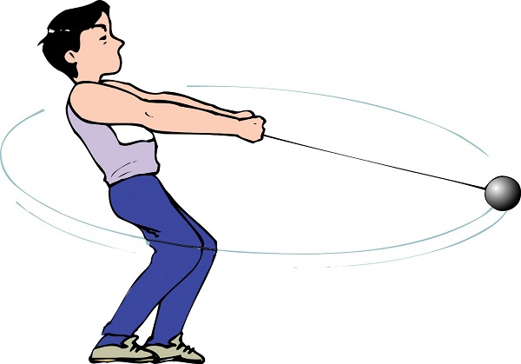
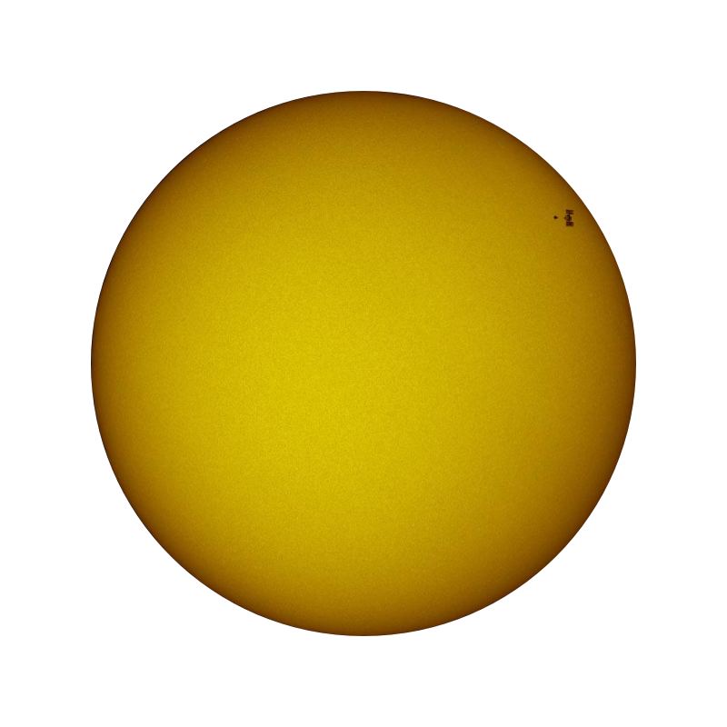
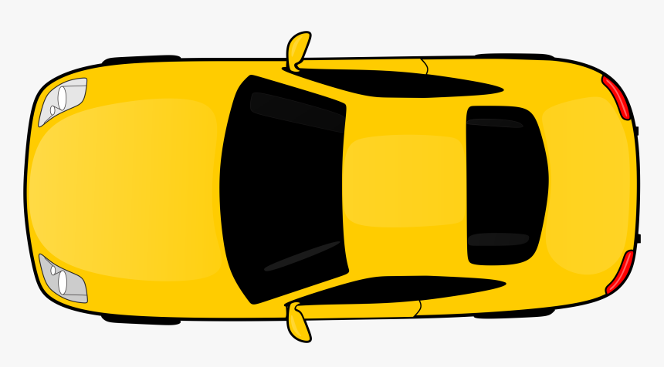
Objects that travel in circular paths. What is the source of the force?
The Earth – Sun System:
A racecar traveling around a turn on the racetrack:
An athlete throwing the hammer:
Gravity
Friction
Tension
F_{g}
$$F_{f}$$
$$F_{T}$$

Slide 14
Example #3:
In example #2, you determined the centripetal acceleration of a race car traveling around a circular racetrack to be 4.4 m/s².
Determine the frictional force acting on the 1500-kg racecar that will allow it to negotiate the turn.
$$F_{net}=F_{f}$$
$$F_{f}=6. 6×{10}^{3}N$$
$$F_{f}$$
Since${ F}_{net}=F_{c}$
${ma}_{c}=m\frac{v^{2}}{r}=$ $F_{f}$
$$F_{f}=(1500kg)(4.4 \frac{m}{s^{2}})$$

Slide 15
The path of objects.
If the centripetal force were suddenly removed from an object moving in a circular path, what trajectory (or path) would it follow?

Slide 16
Which Path?
Why?
Because of Inertia – An object in motion wants to remain in motion at constant speed in a straight line.
If the unbalanced centripetal force is removed, the object will continue in a straight path.
(a)
(b)
(c)

Slide 17
Example #4:
A 1.5 kg cart moves in a circular path of 1.3 meter radius at a constant speed of 2.0 m/s.
Determine the magnitude of the centripetal acceleration.
Determine the magnitude of the centripetal force.
Determine the period.

Slide 18
Example #4: (cont.)
Centripetal Acceleration:
a_{c} = v²/r = (2.0 m/s)²/(1.3 m) = 3.1 m/s²
Centripetal Force:
F_{c} = ma_{c} = (1.5 kg)(3.1 m/s²) = 4.6 N
Period:
T = C/v = 2πr/v = 2π(1.3 m)/(2.0 m/s) = 4.08 s

Slide 19
Motion & Forces
What you already know:
Velocity – a measure of the change in distance over time with direction.
Mass – A measure of the amount of matter an object contains.
Acceleration – A measure of the change in velocity over change in time.
A Net Force – A push or pull that is equal to the mass of the object multiplied by its acceleration (F = ma).

